Slide 1
Category review: Chips
June 2024
Retail Analytics
Brand note: If client logo is not required, use alternate title page layout right click slide thumbnail > Layout > Title

Slide 2
Notes:
To view Privacy video explaining how important data privacy is to Quantium, please click here: https://www.youtube.com/watch?v=Zq1QDAkoRzU
or here Q:\Company Reference\Brand & Design\Brand videos\Q Privacy.mp4
At Quantium, we believe that data is the behavioural footprint of humanity and that it has to be treated with the utmost care and responsibility.
Histories, attitudes, indeed lives are stored within it in ways that aren’t always apparent – and that’s what makes its potential so powerful.
To work with it responsibly, sensitively, we set ourselves the highest data privacy protection and governance standards.
We have spent 17 years perfecting privacy-by-design and secure-by-design principles. Central to this is not holding any personally identifiable information about people –
we neither receive it, and put the necessary protections in place to be unable to decipher it.
Every aspect of handling data is safeguarded: from its de-identification, to its encryption – data security is paramount and of the highest grade.
We pride ourselves on gaining the trust of iconic organisations around the world through years of securely working with their data,
and in turn the trust that builds with their stakeholders.

Slide 3
Executive summary
01
Task 1
High-Level Findings:
Major sales from Budget-older families, Mainstream-young singles/couples, and Mainstream-retirees. Young singles/couples and retirees drive high chip sales due to larger population.
Key Callouts:
Young singles/couples prefer Kettle chips (150g, 175g) 35% more than others. Place these chips in high-visibility areas to encourage impulse buys.
02
Task 2
High-Level Findings:
Trial stores 77 and 88 significantly outperformed control stores in sales. Store 86 showed no significant difference but had an upward customer trend.
Key Callouts:
Verify differences in trial implementation for Store 86 with the client to understand the stagnant sales despite increasing customer count.

Slide 4
01
Category

Slide 5
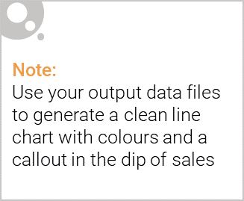
Overview: Life-stage categories key callouts
Young Singles/Couples: Strong preference for Kettle chips, consuming 35% more than other groups; significant impulse buyers. Burger Chips are significantly less popular with a 64% lower preference compared to other groups.
Young Families & Older Families: High chip purchase per customer, driven by greater household consumption.
Young & Mid-age Singles/Couples: Willing to pay more per packet; significant impulse buyers favoring Kettle and Doritos chips.
Retirees & Old-age Singles/Couples : High chip consumption similar to young singles/couples due to a larger population in this segment.

Slide 6

Affluence and its effect on consumer buying patterns.
Mainstream Shoppers: Major contributors to chip sales, especially young singles/couples and retirees. Strong preference for Kettle and Doritos; frequent impulse buys.
Budget Shoppers: Significant sales from older families due to higher purchase quantities and generally prefer lower-cost options.
Premium Shoppers: Prefer healthier snacks; lower chip consumption. Buy chips mainly for entertainment, not regular consumption.
Overall, Mainstream singles/couples are less price-sensitive, paying more per packet. They favor premium brands like Kettle and Doritos, while premium shoppers buy fewer chips overall, valuing health and brand over price. Budget shoppers focus on lower prices and larger quantities.

Slide 7
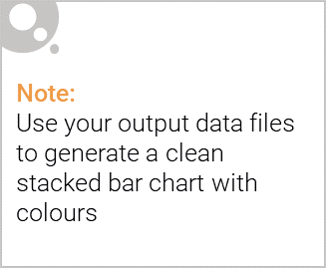
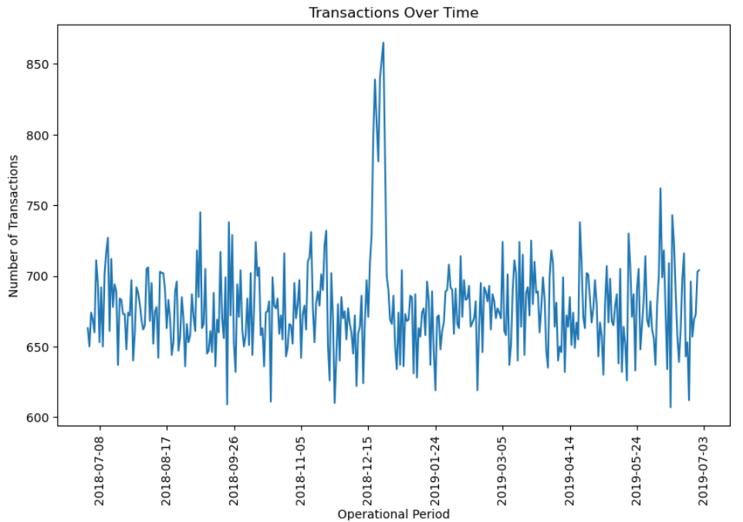
Editable (delete this)
Consistent Transactions count over operational period.
Note: The notable increase is due to Christmas week.

Slide 8
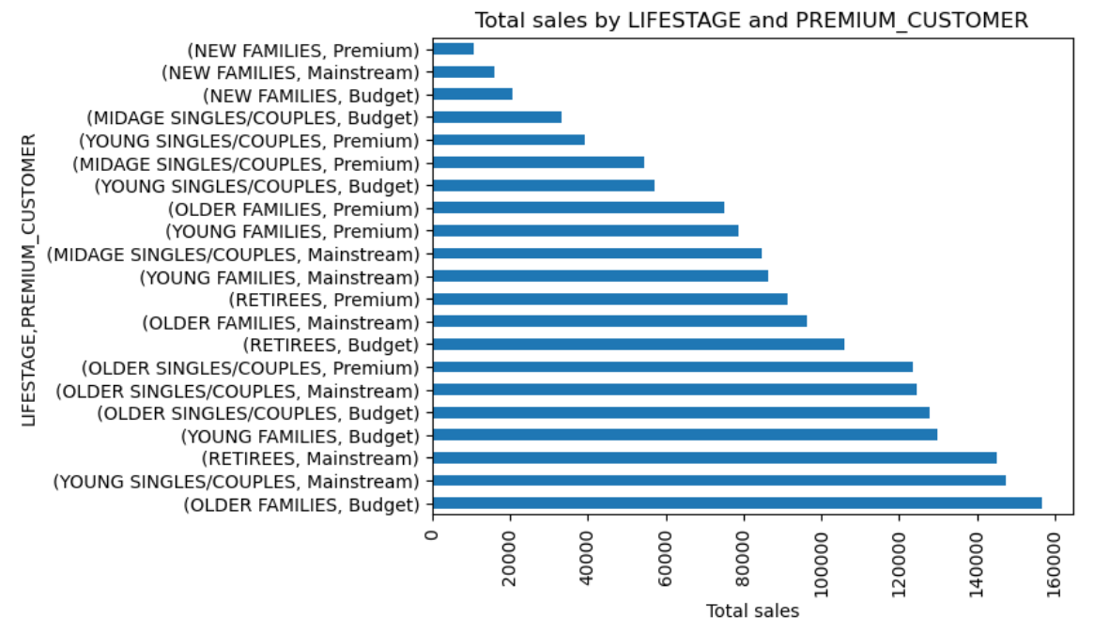
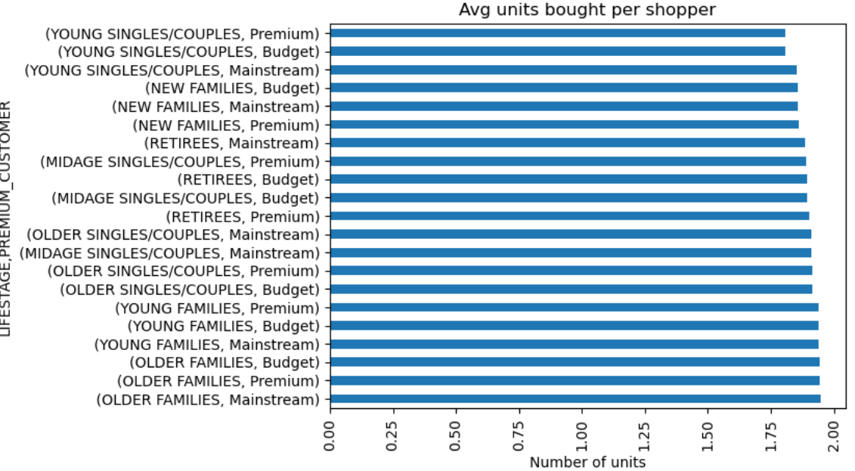
Editable (delete this)
Top Sales: Older Families -> Young Singles/Couples -> Retirees.
Affluency: Consistent among Older Families. Overall, higher in Mainstream as compared to other counterparts.

Slide 9
02
Trial store performance

Slide 10
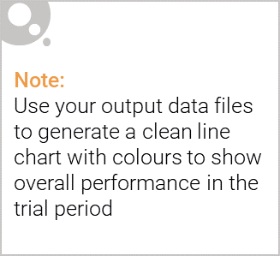
Control store vs Other stores
Control Store:
An established store operational from July 2018 to June 2019.
Selected based on its similarity to a trial store in terms of:
Monthly overall sales revenue & number of customers.
The similarity is measured using:
Average of Pearson correlation & Distance magnitude of sales and customers.
The store with the highest similarity score to the trial store is chosen as the control store.
Other Stores:
Stores not operational for the entire observation period.
Stores that do not match the trial store's pre-trial sales and customer metrics.
Do not qualify as control stores due to lower similarity scores compared to the trial store.
Trial Store -> Calculated Control Store
77 -> 233 || 86 -> 155 || 88 -> 237

Slide 11
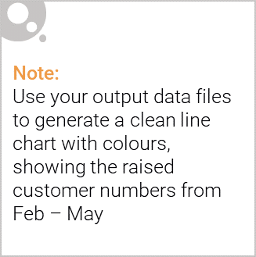
Performance of the trial stores (Successful / Unsuccessful)
Store 77 (Trial vs Control Store 233):
Sales: Significantly higher in 2 out of 3 months.
Customers: Significantly higher in 2 out of 3 months.
Conclusion: Successful trial based on increased sales and customer count.
Store 86 (Trial vs Control Store 155):
Sales: Not significantly different in 2 out of 3 months.
Customers: Increased consistently over all 3 months.
Conclusion: Unsuccessful trial due to no increase in sales, despite increase in customers count.
Store 88 (Trial vs Control Store 237):
Sales: Significantly higher in March & April.
Customers: Significantly higher in March & April.
Conclusion: Successful trial based on increased sales and customer count.
Overall:
Store 77 and Store 88 had significantly higher sales and customer counts than their control stores, indicating successful trials. Store 86 showed no significant sales difference but had an increasing trend in customer count, suggesting a positive impact that needs further investigation into implementation differences.

Slide 12
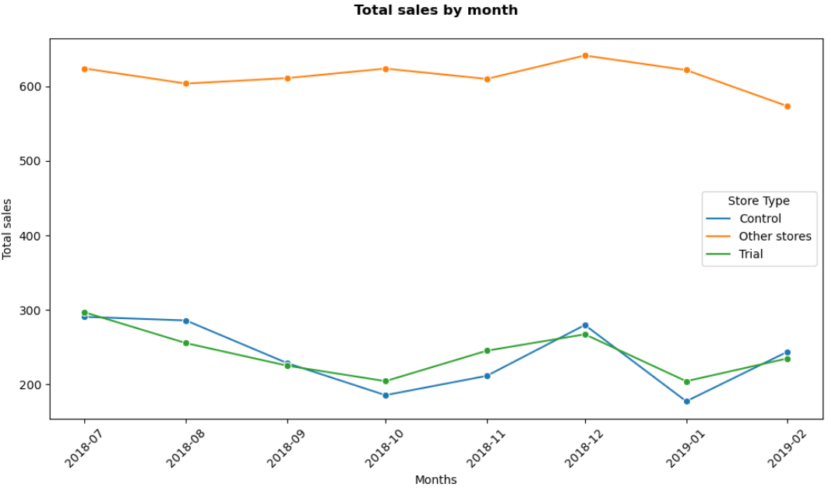
Editable (delete this)
Control stores are calculated to reflect performance of Trial stores.

Slide 13
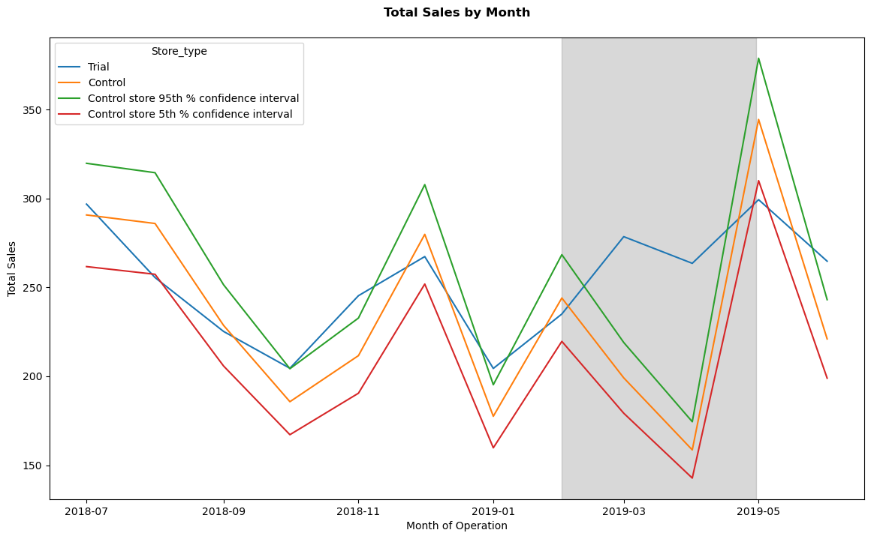
Editable (delete this)
Increase in sales from Feb to April, showing trial stores successfully outperformed control stores due to new store layouts.

